Slide 1
Class Activity

Slide 2
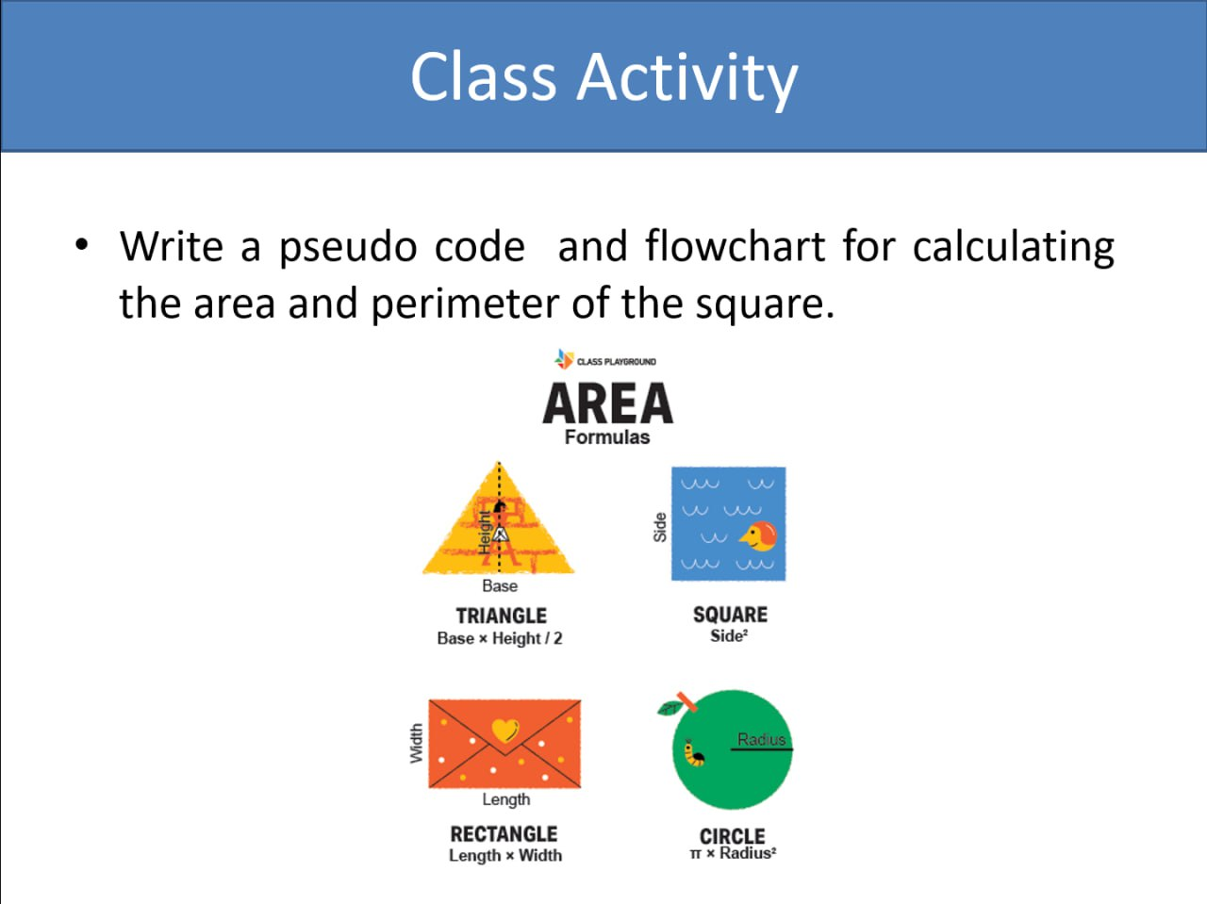

Slide 3
A pseudo code for calculating the area and perimeter of the triangle
Start
Input base and height
Calculate area ← base x height /2
Print area
End

Slide 4
A flowchart for calculating the area and perimeter of the triangle
Start
Input base and height
Calculate area ← base x height / 2
Print area
End

Slide 5
A pseudo code for calculating the area and perimeter of the square
Start
Input side (length)
Calculate area ← side x side
Print area
End

Slide 6
A flowchart for calculating the area and perimeter of the square
Start
Input side (length)
Calculate area ← side x side
Print area
End

Slide 7
A pseudo code for calculating the area and perimeter of the rectangle
Start
Input length and width
Calculate area ← length x width
Print area
End

Slide 8
A flow chart for calculating the area and perimeter of the rectangle
Start
Input length and width
Calculate area ← length x width
Print area
End

Slide 9
A pseudo code for calculating the area and perimeter of the circle
Start
Input radius
Let pi ← 3.14
Calculate area ← 3.14 x radius x radius
Print area
End

Slide 10
A flow chart for calculating the area and perimeter of the circle
Start
Input radius
Let pi ← 3.14
Calculate area ← 3.14 x radius x radius
Print area
End

